Slide 1
DBL Embedded Systems
A sorting machine to sort black and white discs
Group 16
Presenters: Phung D.T. (Dat), Keet M. (Maarten) and Petrescu T. (Tudor)

Slide 2
Subjects
Machine Design
Specification
Priorities
Design Decisions
Software Specification
Software Design

Slide 3
Machine Design
Specification
Priorities
Reliability
Speed
Robustness
Accessibility
Space
Building difficulty
Amount of parts

Slide 4
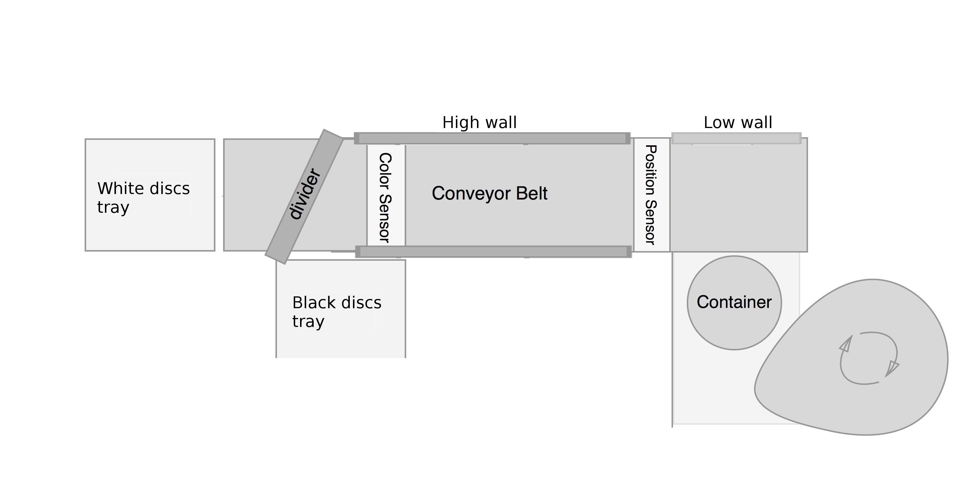
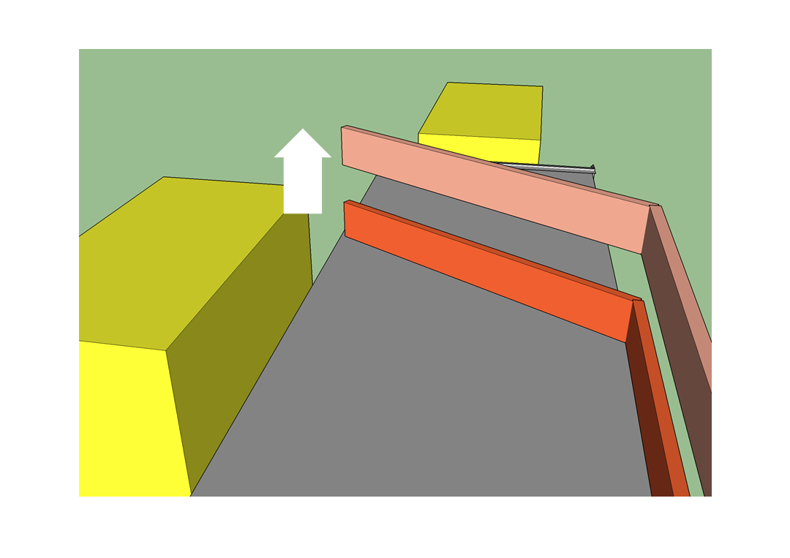
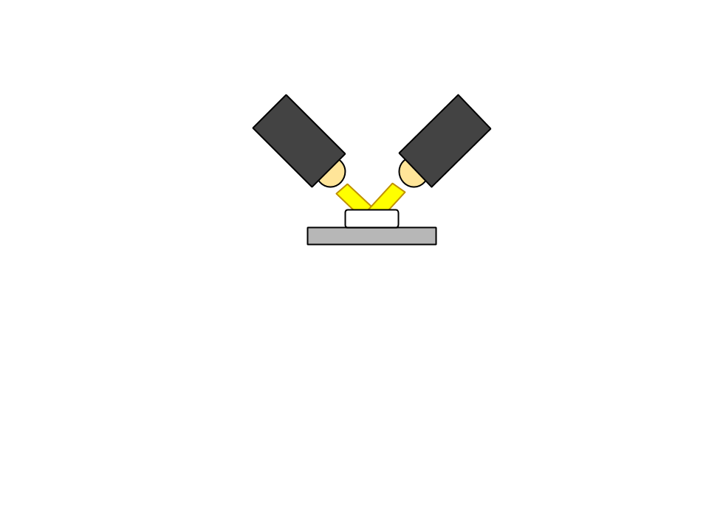
Design Decions
Notes:
tube:
reliable
easily fall
fast
Time between discs
cam
Tilt
Angle
sorter
floor space
faster

Slide 5
Software Specification

Slide 6
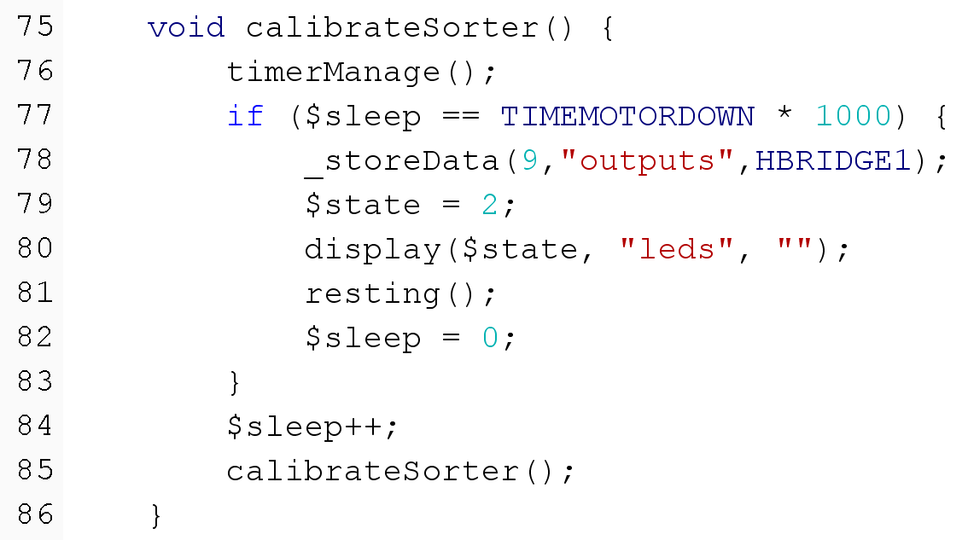
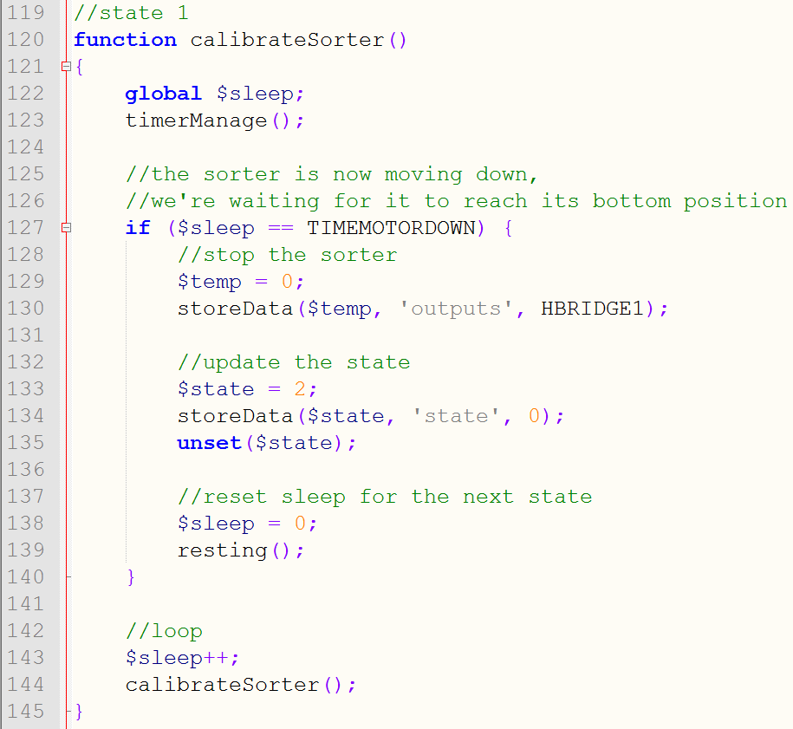
Software Design
Java
PHP

Slide 7
Summary and conclusion
Priorities:
Reliability
Speed
Robustness
User accessibility
Amount of space
Difficulty of building
Amount of parts

Slide 8
Summary and conclusion cont.
Machine parts:
Feeder
Conveyor belt
Sorter
Design decisions software
Push sensor
Position sensor, colour detector, engine conveyor belt and feeder always on
PHP to Assembly compiler
Our machine works correctly

